Slide 1





CREDIT CARD
WEEKLY
STATUS REPORT
1

Slide 2
Contents
Project objective
Data from SQL
Data processing & DAX
Dashboard & insights
Conclusion

Slide 3
Introduction
Welcome to the analysis of Weekly Credit Card Performance. This presentation will provide a professional overview of credit card usage and trends over the past week, allowing for informed decision-making.

Slide 4





Project Objective
To develop a comprehensive credit card weekly dashboard that provides real-time insights into key performance metrics and trends, enabling stakeholders to monitor and analyze credit card operations effectively.

Slide 5




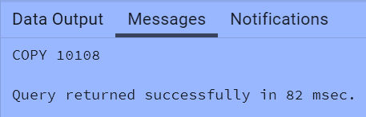

Data Source
GitHub:
https://www.kaggle.com/datasets/credit-card-financial-dashboard-using-power-bi
Imported data to SQL database
Prepared csv file
Created tables in SQL
Imported csv file into SQL

Slide 6

DAX Queries
AgeGroup = SWITCH(
TRUE(),
'public cust_detail'[customer_age] < 30, "20-30",
'public cust_detail'[customer_age] >= 30 && 'public cust_detail'[customer_age] < 40, "30-40", 'public cust_detail'[customer_age] >= 40 && 'public cust_detail'[customer_age] < 50, "40-50", 'public cust_detail'[customer_age] >= 50 && 'public cust_detail'[customer_age] < 60, "50-60", 'public cust_detail'[customer_age] >= 60, "60+",
"unknown"
)
IncomeGroup = SWITCH( TRUE(),
'public cust_detail'[income] < 35000, "Low",
'public cust_detail'[income] >= 35000 && 'public cust_detail'[income] <70000, "Med", 'public cust_detail'[income] >= 70000, "High",
"unknown"
)

Slide 7
DAX Queries
week_num2 = WEEKNUM('public cc_detail'[week_start_date])
Revenue = 'public cc_detail'[annual_fees] + 'public cc_detail'[total_trans_amt] + 'public cc_detail'[interest_earned]
Current_week_Reveneue = CALCULATE( SUM('public cc_detail'[Revenue]), FILTER(
ALL('public cc_detail'),
'public cc_detail'[week_num2] = MAX('public cc_detail'[week_num2])))
Previous_week_Reveneue = CALCULATE( SUM('public cc_detail'[Revenue]), FILTER(
ALL('public cc_detail'),
'public cc_detail'[week_num2] = MAX('public cc_detail'[week_num2])-1))

Slide 8
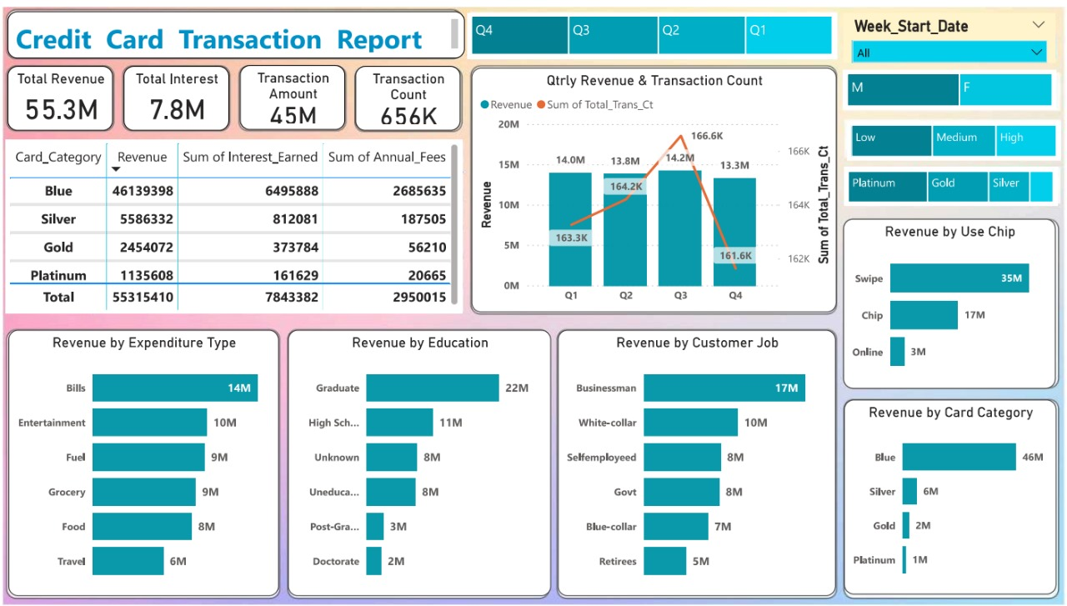
10

Slide 9
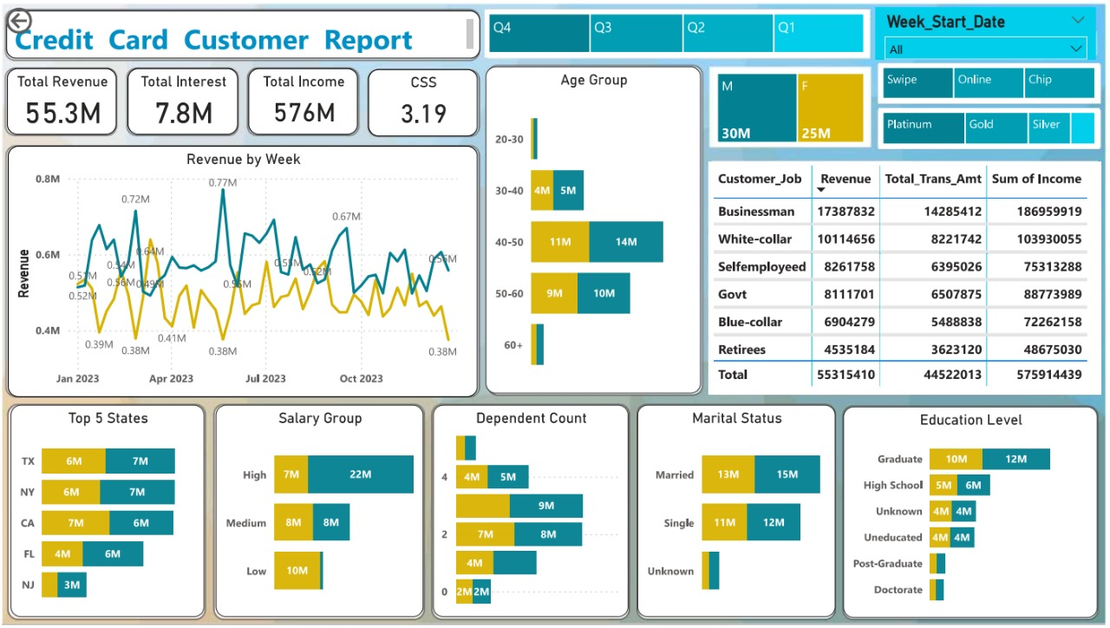
10

Slide 10

Project Insights - Week 52 (24th Dec)
WoW change:
Revenue decreased by 12.8%,
Total Transaction Amt & Count decreased by 13.48% & 11%
Customer count decreased by 15.9%
Overview YTD:
Overall revenue is 55.3M
Total interest is 7.8M
Total transaction amount is 45M
Male customers are contributing more in revenue 30M, female 25M
Blue & Silver credit card are contributing to 93.5% of overall transactions
TX, NY & CA is contributing to 69%
Overall Activation rate is 57.47%
Overall Delinquent rate is 6.07%

Slide 11

Conclusion
In conclusion, this analysis provides valuable insights into the weekly credit card performance and offers actionable strategies for optimizing performance, mitigating risks, and driving business growth. Leveraging these insights will lead to a competitive advantage in the market.

Slide 12
Thank you !
12

